Slide 1
Lessons Learned at National Conference
Roger Poling
Iowa Jump$tart conference
July 2010

Slide 2
Preview
What We Teach
Why We Teach It
Who Should Teach It

Slide 3
Advocating for Financial Literacy Education
Jump$tart National Financial Literacy Conference for Educators
November 7, 2009
Washington, DC
Barbara Kapinus
Sr. Policy analyst
National Education Association

Slide 4
21st Century Content
Subjects
  World languages
  Arts
  Mathematics
  Economics
  Science
  Geography
  History
  Government and Civics
21st Century Themes
  Global awareness
  Financial, economic, business and entrepreneurial literacy
  Civic literacy
  Health literacy

Slide 5
21st Century Content
ICT Literacy
Collaboration Skills
Critical Thinking & Problem Solving
Creativity and Innovation Skills
Life and Career Skills
Support Structures

Slide 6

A one-stop-shop for 21st century skills-related information, resources and community tools.
http://www.21stcenturyskills.org/route21/index.php

Slide 7
In education, the questions we ask are very important.

Slide 8


Are our students globally aware?
Are our students critical thinkers and problem solvers?
Are our students self-directed?
Are our students good collaborators?

Slide 9
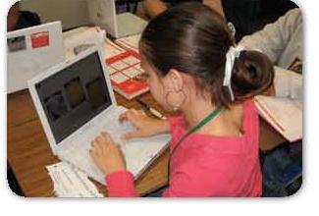
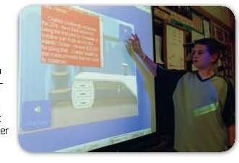
Are our students information and technology literate?
Are our students flexible and adaptable?
Are our students innovative?
Are our students effective communicators?

Slide 10
Rationales for Financial Literacy Education
21st Century Skill
Incorporates other 21st century (transdisciplinary) skills
Important in order to provide access and close the financial achievement gaps
Promotes informed, responsible citizenship

Slide 11
Shift Happens
What do we think it means to prepare students for the 21st Century?
What skills do students need to survive and thrive in this new era?

Slide 12

























P21 MemPpbPartnersers

Slide 13
Partnership’s Goal
Every Child possesses 21st Century skills essential to a successful life of learning, work, and civic engagement

Slide 14
We must establish a support for quality 21st century education as the engine that will drive economic and civic viability.

Slide 15
Key to a Better Life
Provides a means of breaking the cycle of poverty.
Improves financial responsibility.

Slide 16
A Better Future for All
Develops an understanding of financial aspects of responsible citizenship

Slide 17
If we don’t teach it, who will?
Financial Literacy is being taught in every home and every school in the country
The problem is the quality of the “teachers” and the lessons learned.

Slide 18
A new NEFE study finds:
89 percent of K-12 teachers believe students should take a financial literacy course or pass a test for high school graduation

Slide 19
More than 60 percent feel unqualified to use their state's financial literacy standards

Slide 20
But more than 70 percent say they are willing to get formal financial education training

Slide 21
Original presentation by
Andrea Prejean
aprejean@nea.org
Barb Kapinus
Bkapinus@nea.org

Slide 22
Should you go this fall?
Great Networking Opportunities
Fabulous Food & Drink
Amazing Sites (Fed Res Bldg)
Wonderful Speakers
Loads of Fun
Important Celebrities

Slide 23
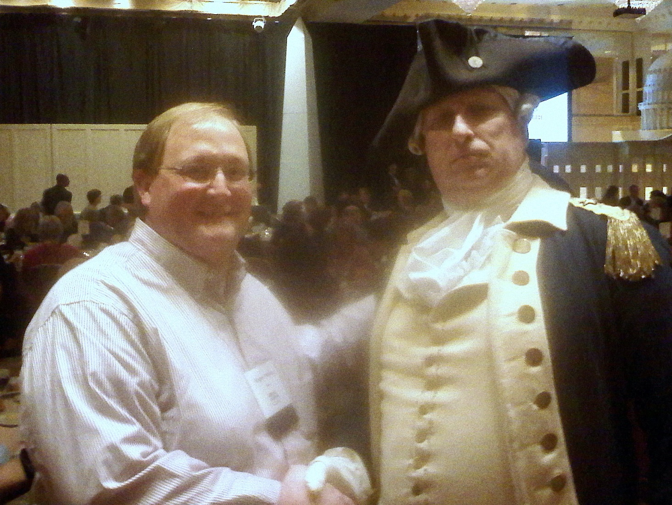
Anyone have a Dollar?

Slide 24
Additional Questions
Contact:
Roger Poling
Roger.poling@gmail.com

