Slide 1
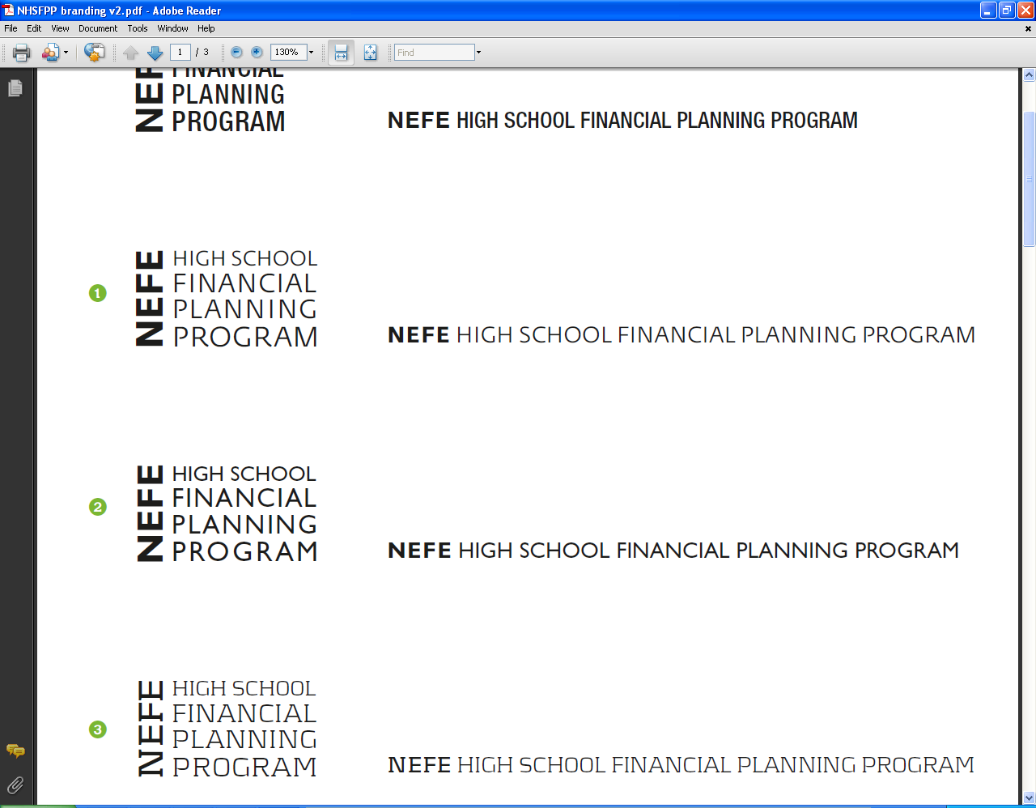

www.hsfpp.org
NEFE/Extension Representative
Mary Beth Kaufman
Family Finance Program Specialist
Notes:
Introduction to the High School Financial Planning Program® (HSFPP)
National Endowment for Financial Education® (NEFE®)

Slide 2



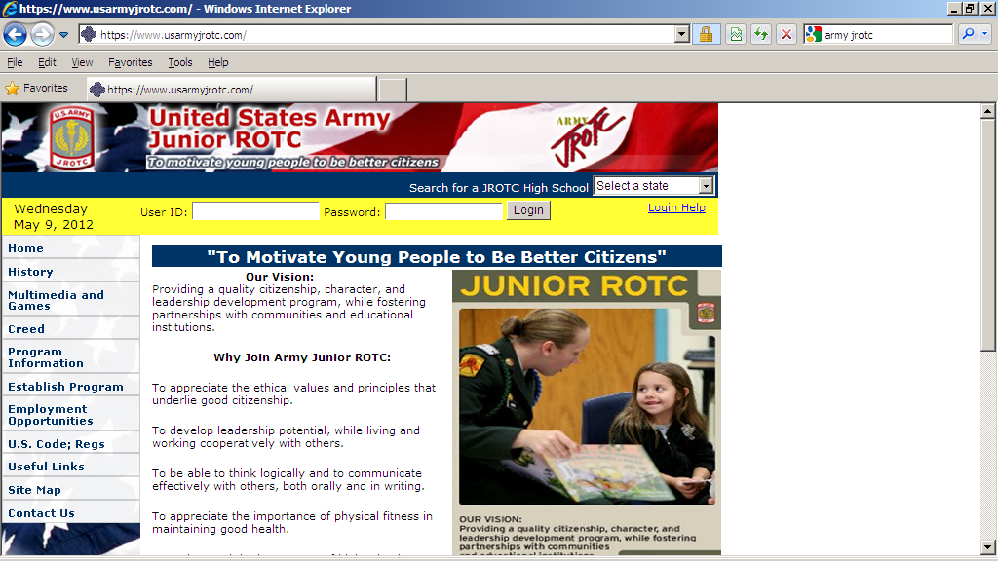

HSFPP Partners
Notes:
Talking Points:
Point out that the High School Financial Planning Program is a public service of the National Endowment for Financial Education in Denver Colorado, working in partnership with the National Institute of Food and Agriculture and the Credit Union National Association and America’s Credit Unions.
Through these partnerships, NEFE utilizes a national network of state representatives to introduce the high school program to schools and youth organizations. These Cooperative Extension reps and Credit Union reps will also facilitate instructor training and help instructors connect with personal finance resources.
Point out the state representatives, their titles, and organizations so the audience knows who to reach out to for more information or local assistance.

Slide 3

The National Endowment for
Financial Education is . . .
A nonprofit, noncommercial, independent, 501(c)(3), self-funded, private foundation based in Denver, Colorado.
NEFE inspires empowered financial decision-making for individuals and families through every stage of life.
Notes:
Talking points:
NEFE is a nonprofit, noncommercial foundation dedicated to empowering individuals for
financial decision-making through all stages of their lives.
In the 1980s the foundation evolved from the College of Financial Planning® to meet a need of providing reliable, impartial financial information to consumers, particularly the underserved.
The HSFPP is the flagship program of NEFE, and now many other no-cost resources are available, including resources for teens that will be introduced during this presentation.

Slide 4
NEFE Reaches Consumers
Notes:
Talking points:
Provide a general overview of who NEFE serves, how NEFE works with others, and what NEFE provides.
Examples of how NEFE serves consumers include personal finance curriculum for educators, instructional materials for workshop facilitators, and website resources for consumers.
NEFE strives to reach those who will benefit from increasing their financial know-how yet may not know about or currently receive services from a local school, community organization, financial institution, or financial professional.
NEFE partners with other financial educators and practitioners to reach consumers with credible, noncommercial personal finance resources and strategies.
Examples of NEFE partnerships and alliance activities include NIFA’s Cooperative Extension, Credit Unions, the Jump$tart Coalition, Catholic Charities, the Red Cross, and the National Military Family Association. Additional partnership activities can be found at www.nefe.org under Who We Help/Partners.
Examples of NEFE research include the University of Wisconsin study about teacher preparedness, and the current longitudinal study of student financial behaviors at the University of Arizona. Summaries of all NEFE-sponsored research can be found at www.nefe.org under Research.
NEFE has an ever-growing collection of financial literacy including the HSFPP, Financial Workshop Kits for adult workshops, and consumer resources at www.smartaboutmoney.org.

Slide 5
Something Every Student Should Know
NEFE’s High School Financial Planning Program
equips students in Grades 8-12
with fundamental personal finance skills
to prepare them for financial independence
and mindful money management
decisions and behaviors
Notes:
Talking Points:
Since the mid-80s the HSFPP has reached nearly 8 million students across the country and at over 100 military bases around the world.
The HSFPP is designed for teachers and youth mentors who want to help students get off to a good start managing their finances on their own.
The program is designed for in-person teaching. It works well in the classroom, workshops, and one-on-one situations.
The program is used in public and private schools, home school settings, community youth programs, scouts, 4-H, church seminars, JROTC programs, adult and youth learning centers, and juvenile detention centers.
After each revised version of the program is in circulation for two to three years, the program impact has been evaluated. The most recent study of the program revealed that students who participated in the HSFPP increased financial knowledge, confidence, and ability to apply what they have learned.

Slide 6
2012 HSFPP Program
What is the Same?
Print Student Guide
Instructor manual with lessons
Visual aids on CD or downloadable
Performance-based learning
Evaluation templates & rubrics
Aligned to academic standards
Face-to-Face Training
Facebook
All available at No Cost

Slide 7

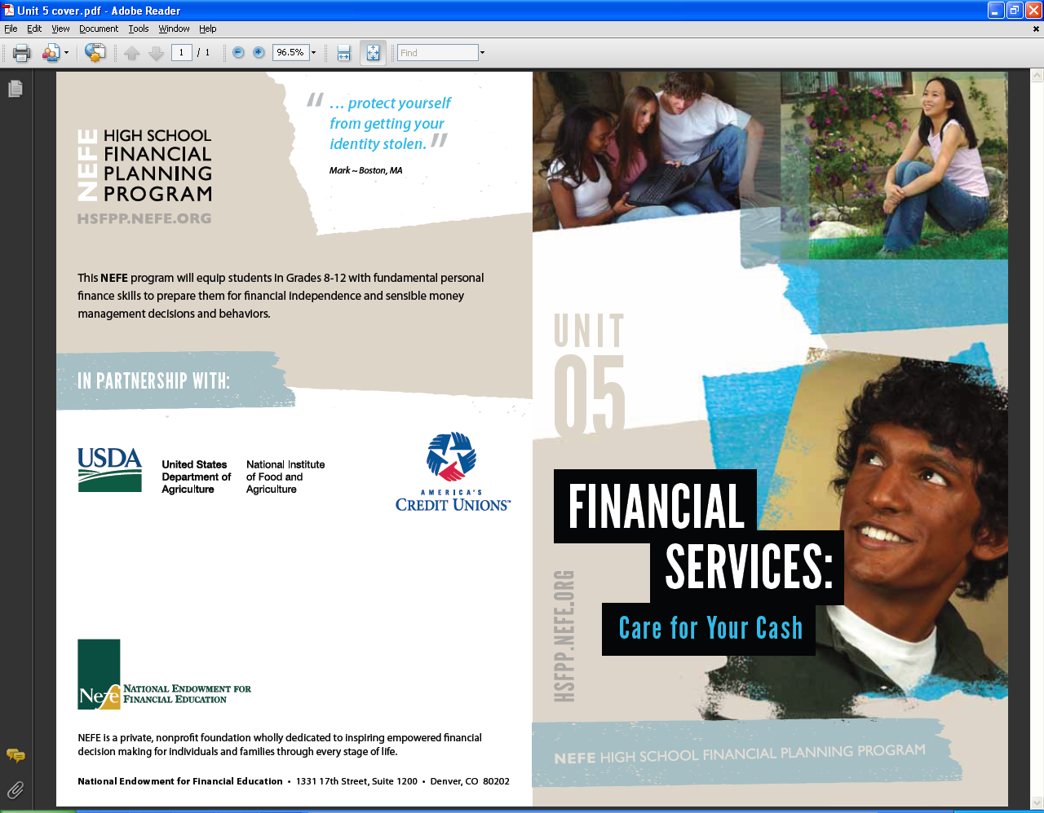
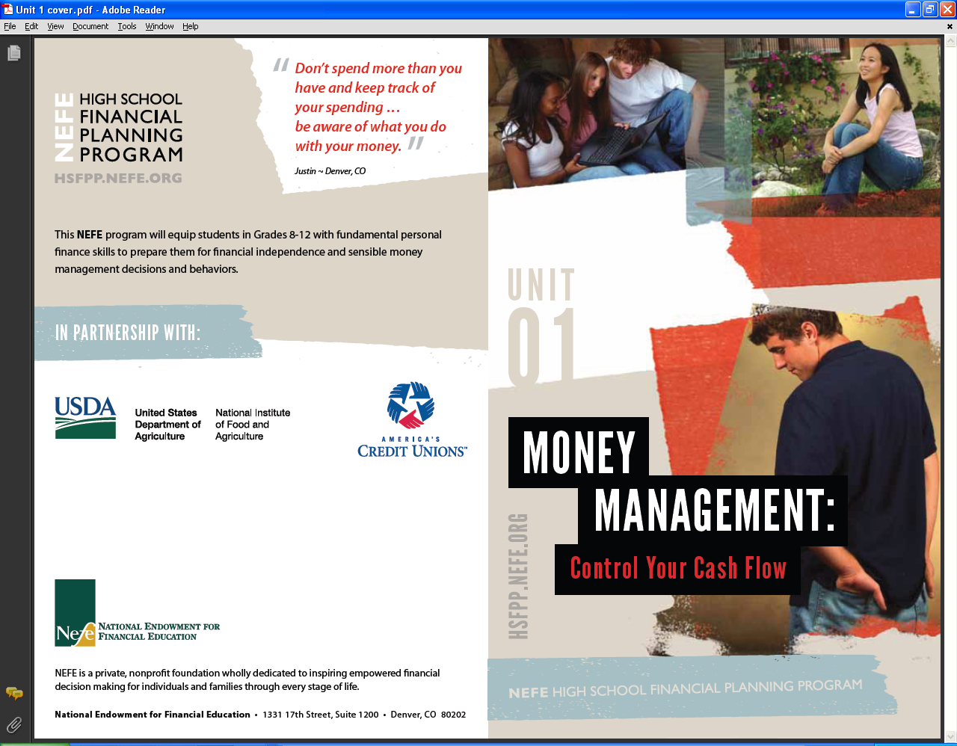
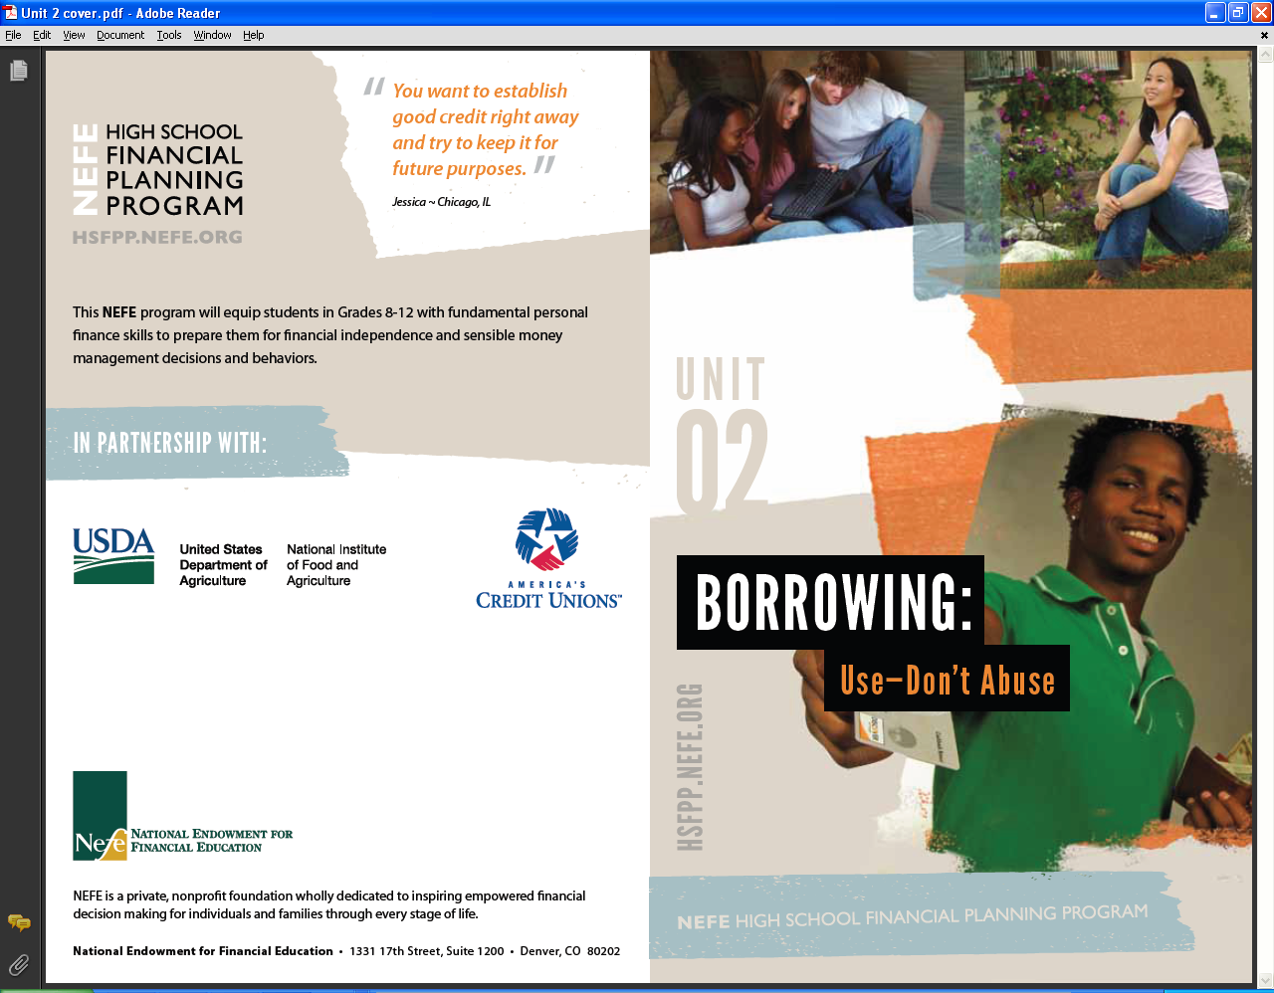
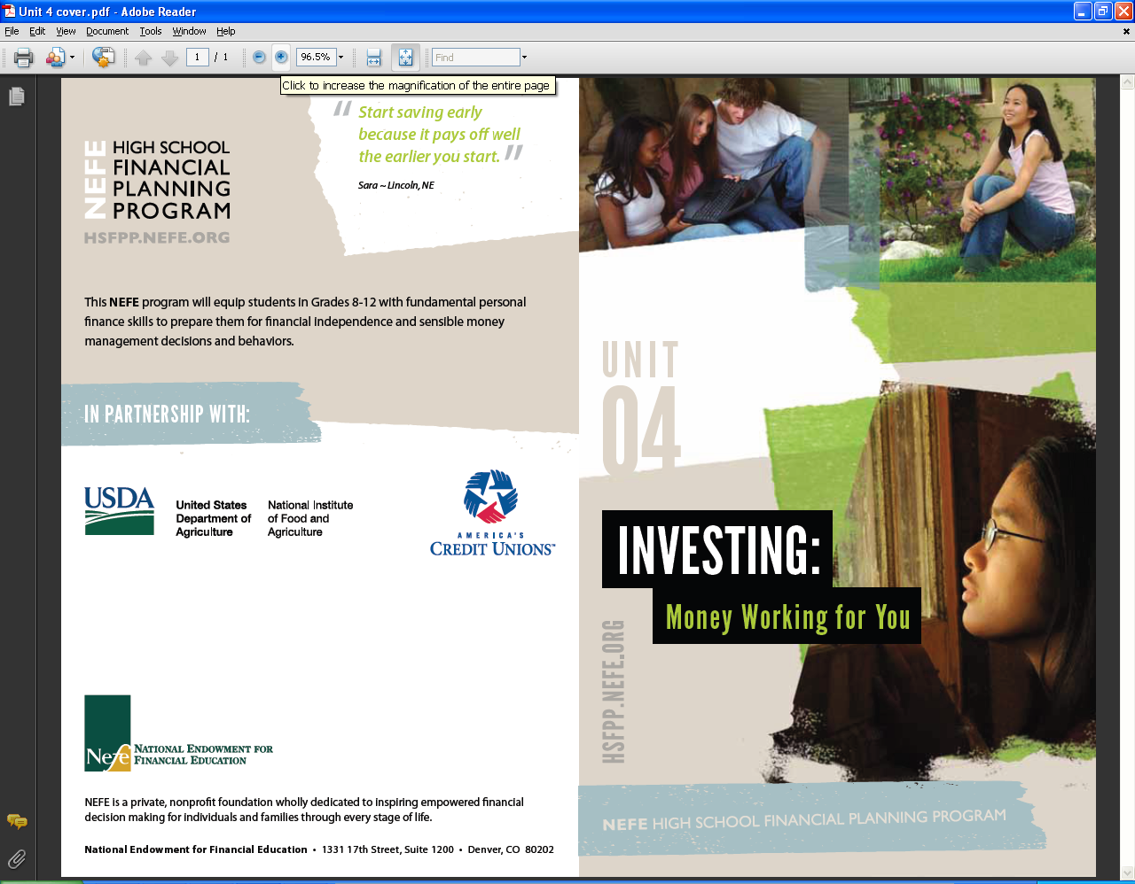

2012 HSFPP Program
What is New?
Six Topical Modules:
  Separate Student Guides
  Use one, some, or all
  Core skills integrated through all
Series of 6 Student Guides
  40-page booklets (8 ½” x 5 ½”)
  Foundational Personal Finance principles relevant to teens
  Teens stories imbedded into content

Slide 8

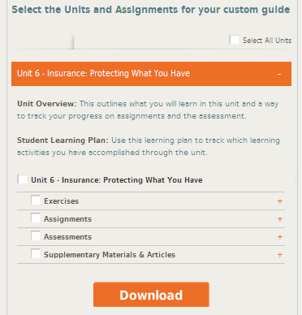
Module Components
Online
instructional resources
Teacher
lesson
plans
Student Guide booklets
Notes:
Note:
Custom animation is set in this slide so each of the three components automatically appears in succession: online instructor resources, teacher lesson plans, Student Guide booklet.
Talking Points:
Every module includes:
online learning resources (to be viewed later in this presentation)
a Student Guide booklet (point out the example in the Info Kit)
teacher lesson plans (point out the example in the Info Kit)
The curriculum is designed so educators can teach the 45-minute lessons in any sequence they decide based on their local requirements and students needs.
Teachers have the flexibility to select which modules and lessons they want to use, some or all, based on what they have time to cover in their curriculum.
Teachers also have flexibility to extend learning beyond the HSFPP materials. For example, a teacher might use the IRS.gov Understanding Taxes program as an add-on to the HSFPP Earning Potential module.

Slide 9
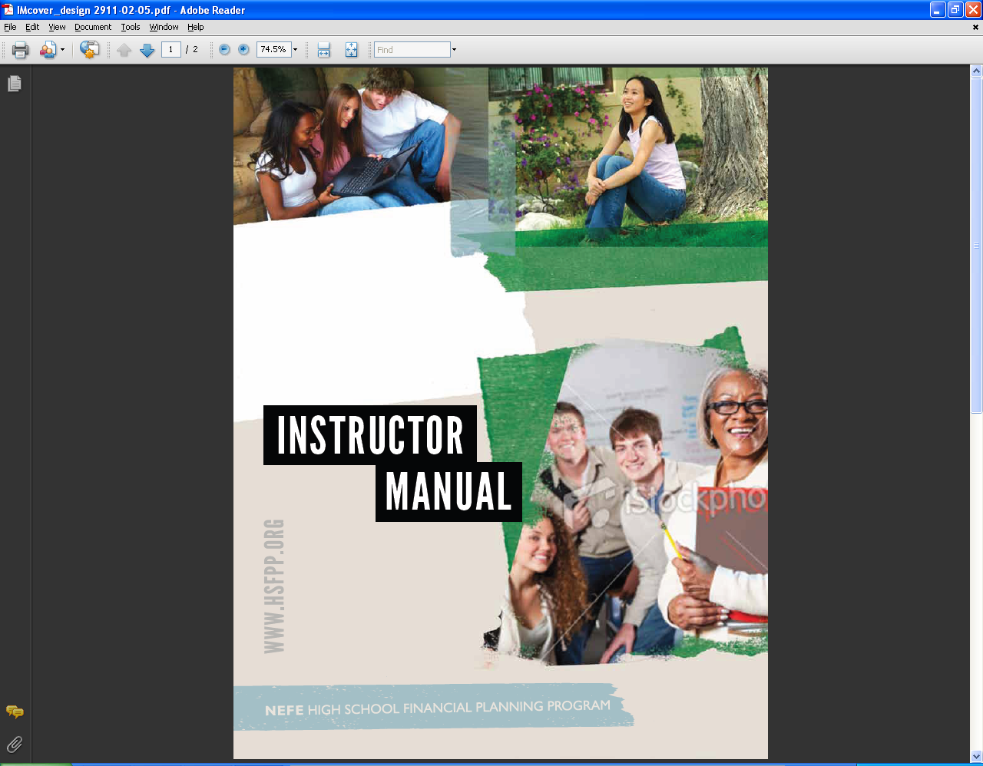
Instructor Materials
Online resources, www.hsfpp.org
  Continually growing collection of lessons and resources
  Online calculators
  Teacher Forum and Facebook to share ideas
Instructor Packet, option to order
  Five fundamental lesson plans per Guide
  Complete set of six Student Guides
  Learning material masters and templates
Notes:
Talking Points:
Teachers can access the lessons plans and learning materials in two ways:
Register on the website to be able to download the materials they want to use.
Register to order an Instructor Packet that includes instructional materials for
30 lessons.
Each Student Guide has at least five matching lesson plans with supporting learning materials and visual aids.
The Instructor Packet will only include a portion of what is available from the full suite of online instructional materials. If feasible, display the Teacher Page at www.nefe.org as
you show the following slides.

Slide 10

Website
What is New?
New URL: www.hsfpp.org
  Growing collection of lessons (MS, HS, transition)
  Student polls
  Student check quizzes
  Customizable course syllabus
  Links to calculators
  Instructor and Network forum
  Map widget to locate training events, state reps
  Videos & online simulations – coming later in year
Notes:
Growing collection of learning materials
(MS, HS, transition beyond HS)
Financial calculators
Student polls
Student check quizzes
Teacher forum
Financial literacy and program news
Map widget to locate training events, state reps

Slide 11
6 Program Modules
Module Topics | Learning Outcomes
1. Money Management | Manage your spending.
2. Borrowing | Control your credit and debt.
3. Earning Potential | Boost your earning capacity.
4. Investing | Make the most of your financial resources.
5. Financial Services | Choose financial services that are right for you.
6. Insurance | Protect your financial resources.
Notes:
Prop:
Student Guide booklet (inside front cover of any booklet)
Talking Points:
The program materials are categorized into six topical modules as shown in the slide and inside cover of each Student Guide. Point out the list of modules in the inside front cover of the Student Guide.)
Each module targets an overall foundational personal finance learning outcome.
Each module is made up of multiple lessons and learning activities.
Each lesson targets a competency that addresses one or more program learning outcomes.
The lessons are designed so students practice and apply what they learn (the target competency) as a result of the learning experience.
Each module also includes performance assessments that measure a student’s ability to actually perform target competencies under authentic conditions. For example, rather than answer multiple choice test questions to explain what is in a budget, students will actually create budgets using their own data or provided sample data.

Slide 12
5 Transferable Skills
Integrated Throughout the HSFPP
Set goals that are SMART.
Use a decision-making process.
Analyze how personal values impact behaviors.
Utilize resources that are credible and timely.
Manage personal records.
Notes:
Props:
Page 40 of any Student Guide.
Talking Points:
In multiple places throughout the program, students have opportunities to reinforce skills that relate to multiple program outcomes.
These transferable skills can applied in other settings beyond the personal finance course or workshop.
See examples of two memory aids featured on page 40 of any Student Guide:
SMART Goal Guide
DECIDE Steps

Slide 13
Student Guide Series
One booklet per module
(6 total)
Use one, some, or all
Activities are mixed with basic personal finance theory
Content is relevant to teen lives, Grades 8-12
Notes:
Note:
As you display the next slide, reference pages in Module 1 so participants can look through the booklet during the presentation.

Slide 14
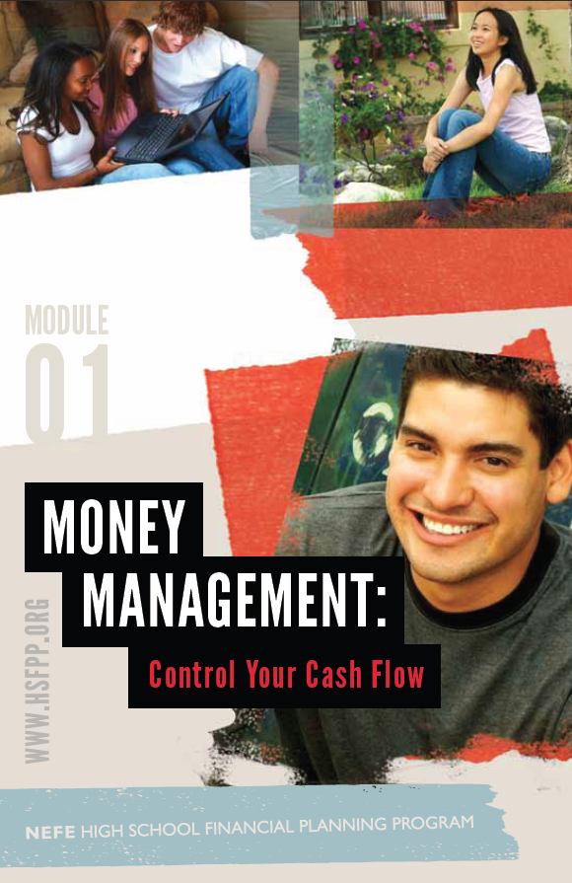
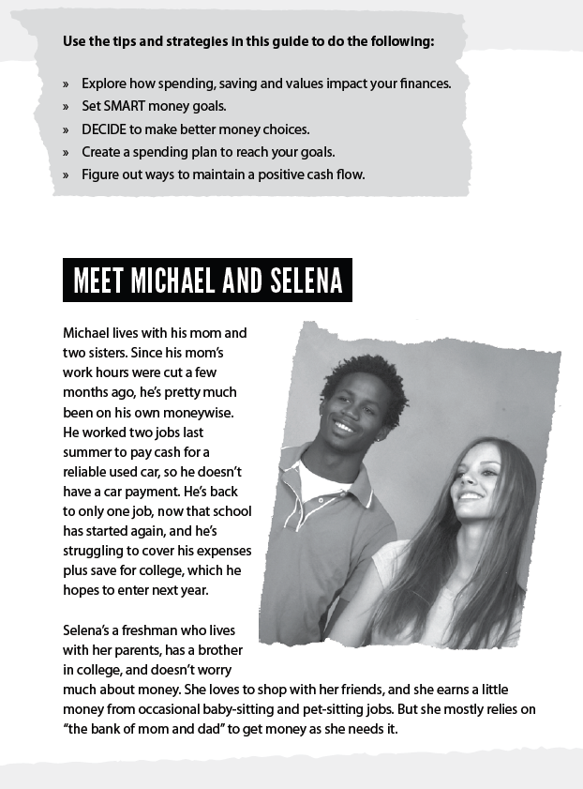
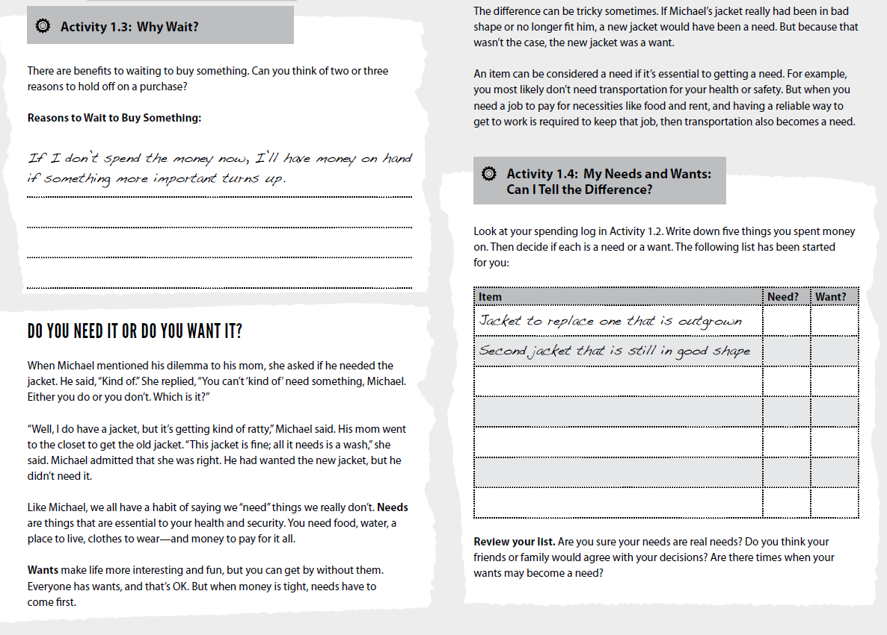
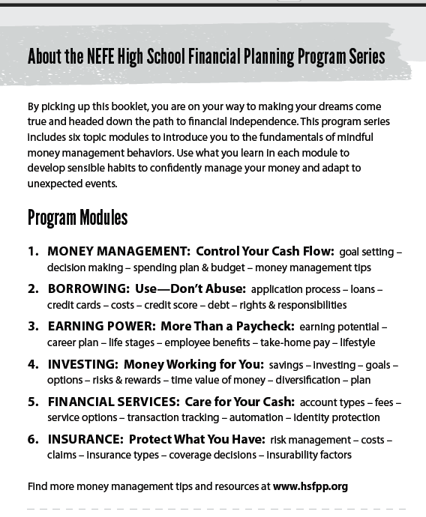
Student Guide Style
Notes:
Note:
Custom animation is set in this slide so five different pages are displayed as you click through the presentation.
Talking Points:
Click #1: The inside cover of each Guide lists all of the program module titles with a preview of the module content.
Click #2: Each Guide features two teen case studies throughout the booklet as readers follow one student in either Grade 11 or 12 and another student in either Grade 9 or 10 while they learn about the personal finance concepts in the booklet. (Module 1 features senior-student Michael and freshman Selena on page 3.)
Click #3: In each Guide and the online lessons plans, you will find activities that have been identified as favorites of teachers and students who have used the program materials in the past. (As an example, point out the Wants and Needs activity in Module 1, page 11.)
Point out that activities kept from previous program materials have been refreshed with data to reflect current times, and new activities have been added to the booklets and in the online materials for expanded learning opportunities.
Each Student Guide is a different color for quick identification.
The Student Guides are designed to cover the basics of personal finance that seem most relevant to students in Grades 8-12. Further learning and additional concepts will be available in the ever-growing collection of online activities.
Teachers can access the Student Guides in two ways:
By placing an order to request a shipment for what they will use with students,
whether some or all of the booklet series. Shipment is at no cost and takes approximately four weeks.
By downloading the Guides in .pdf format from the website to access immediately.

Slide 15
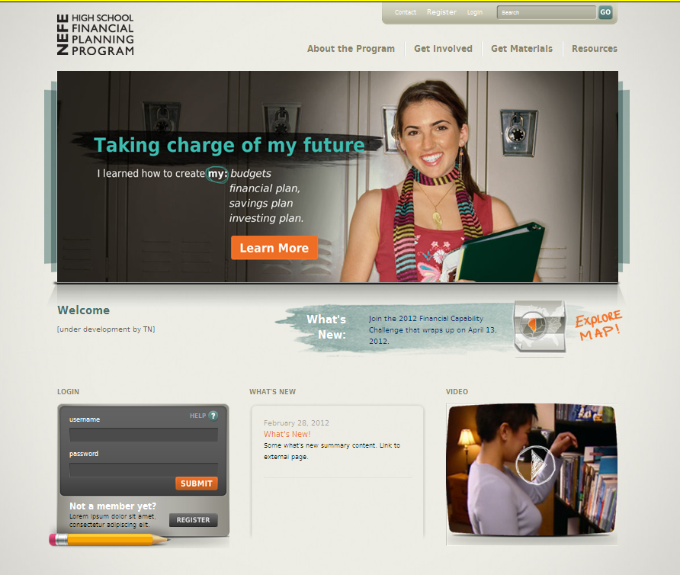
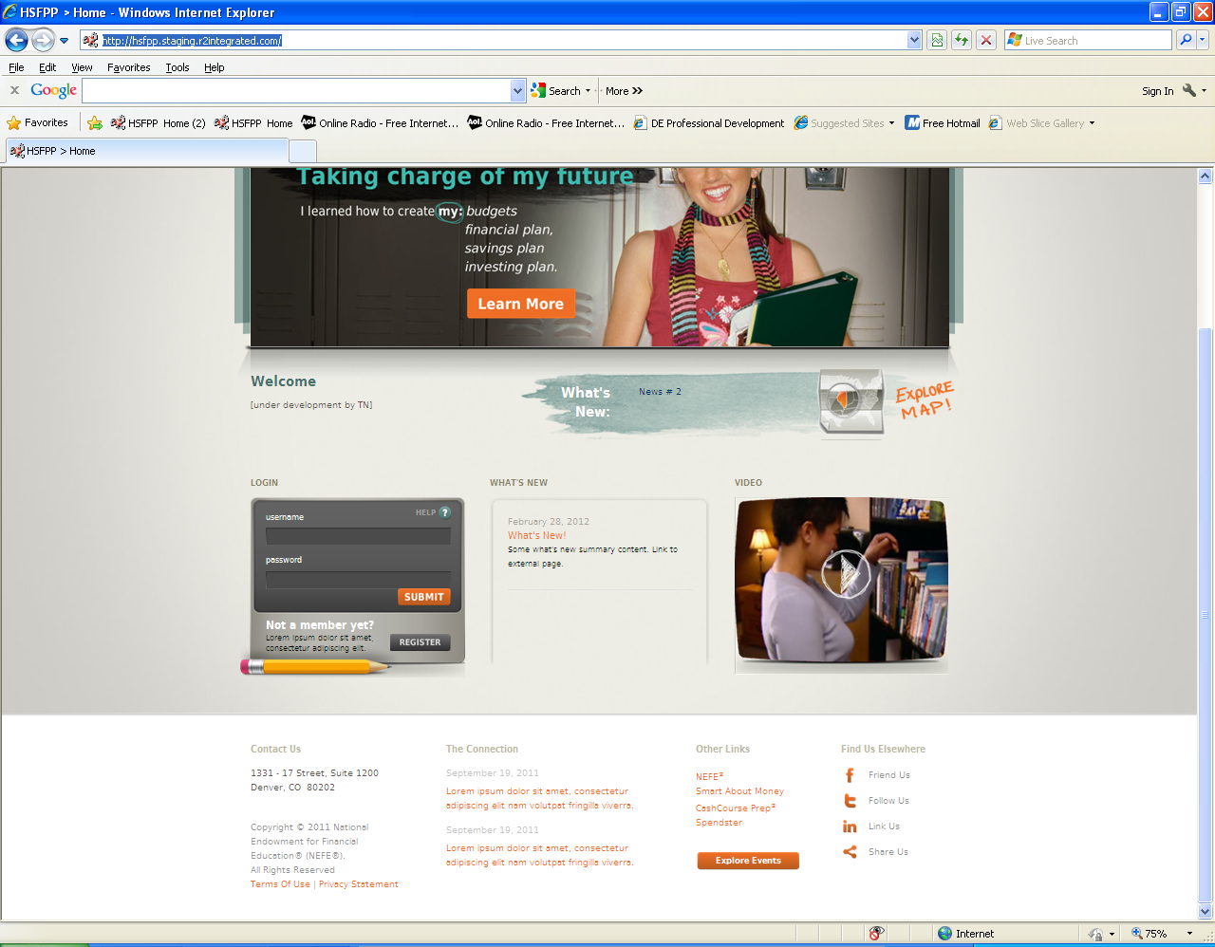
Home Page
Public Access
How to use the program
How to get involved
How to order or download
News about HSFPP
Financial literacy news
Link to state map
for contact and training info
Links to other NEFE resources
Notes:
Prop:
If feasible, log into the Home page of www.hsfpp.org for tour of site at this time.
Note:
Past/Current HSFPP teachers and sponsors will continue to use their existing User Names and Passwords. Their category at time of registration will grant them access to the web tools available specifically for teachers, sponsors, and Network Reps.
Students will login to access student content, but their personal contact information will not be requested.
Talking Points:
The www.hsfpp.org Home Page is where the public can access the following:
About the Program
How to Get Involved with HSFPP
How to Get Materials
HSFPP Resources
To access all program resources, users will need to register as students, teachers, or sponsors.

Slide 16
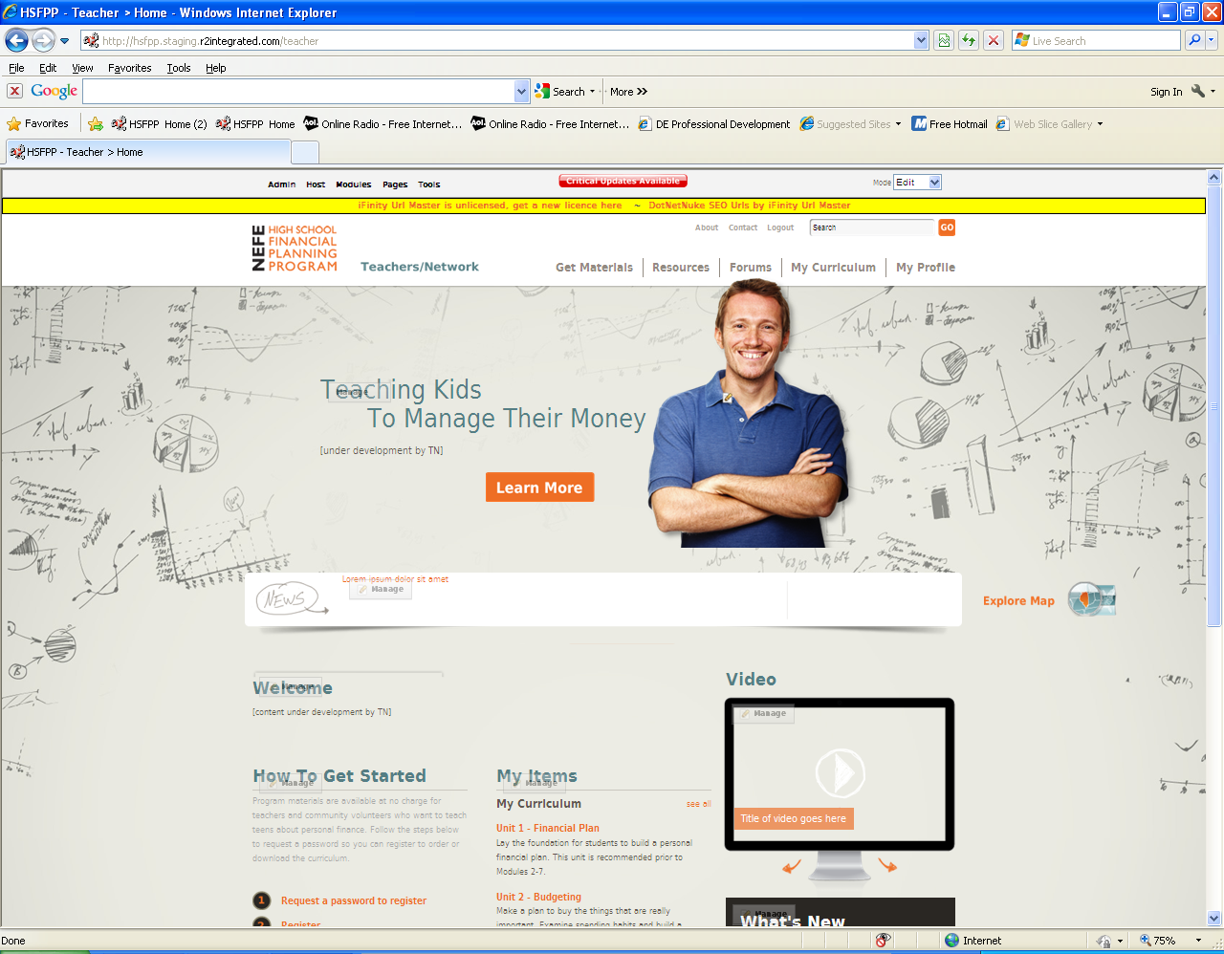
Educator Page
Must register to access
Same log-in info as in past
Order or download materials
News for educators
Online calculators
Training resources for trainers
State map for contact and training info
Discussion forum
Notes:
Prop:
If feasible, log into the Teacher landing page of www.hsfpp.org for tour of site at this time.
Note:
Past/Current HSFPP teachers and sponsors will continue to use their existing User Names and Passwords. At the time of registration, they will receive rights to web tools specifically available to teachers.
Talking Points:
The www.hsfpp.org Teacher Page is where the program educators can access the following:
Teacher Forum
Lesson Plans, assessments, scoring rubrics, PowerPoint presentations
Training videos and tips

Slide 17

Student Page
Register via teacher to access
View or download materials
Polls and check quizzes
Worksheet templates
Online calculators
Personal finance resources
Notes:
Prop:
If feasible, log into the Student landing page of www.hsfpp.org for tour of site at this time.
Note:
Students will login to access student content, but their personal contact information will not be requested.
Teachers will have access to everything on the Student pages.
Talking Points:
The www.hsfpp.org Student Page is where the HSFPP students can access the following:
Learning activities as assigned by the teacher
Worksheet templates (i.e. Budget spreadsheets, decision-making forms)
Online check quiz
Online poll
Online financial calculators
Student Guides in .pdf format

Slide 18
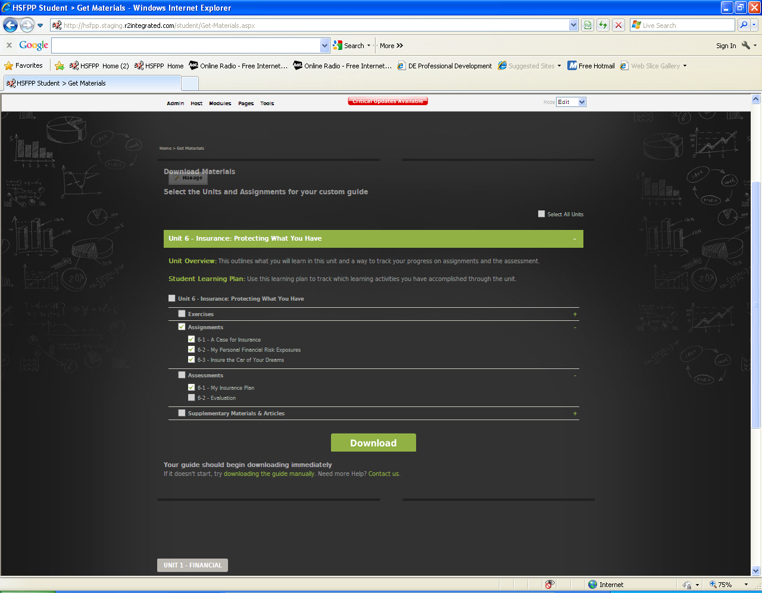
Download Curriculum
Must register to access
Select desired lessons, activities, assessments
Notes:
Prop:
If feasible, show the Download Curriculum feature in the Teacher section at www.hsfpp.org.
Talking Points:
Users must be registered and logged in to access the Download feature.
All HSFPP learning materials will be available in electronic format.
Teachers can select the activities they want to use during a particular learning experience.

Slide 19
Benefits to Teachers & Youth Mentors
Easy to use
Turnkey curriculum
Designed by educators and experts
for educators and teens
Adaptable to classroom or workshop settings
Flexible for program time limitations
No cost
Notes:
Talking Points:
Whether experienced or inexperienced in teaching personal finance, educators who use the HSFPP materials will have a positive impact on the students they teach.
Educators have everything they need to teach teens about personal finance while having the flexibility to use materials from other programs to extend and/or reinforce learning.

Slide 20
Benefits to Students
Apply to teen lives
Gain fundamental personal finance knowledge
Build confidence in financial decision making
Instill sound money management practices
Lay foundation for life-long habits
Notes:
Talking Points:
By using the program to teach teens, you are giving students tools to immediately apply the skills they learn and providing them the ability to adapt their habits, skills, and attitudes for future situations.

Slide 21
Aligned to National Standards
Jump$tart Coalition for Personal Financial Literacy
National Standards in K-12 Personal Finance Education
Financial Literacy and Education Commission Core Competencies
National Standards for Business Education-Personal Finance
Council for Economic Education
Voluntary National Content Standards in Economics
National Standards for Family and Consumer Sciences Education
Partnership for 21st Century Skills
Notes:
Talking points:
The HSFPP learning outcomes were drawn from industry expectations and recognized national academic standards related to personal finance.
Links to national personal finance standards as of May 2012:
Jump$tart Coalition for Personal Financial Literacy National Standards
in K-12 Personal Finance Education
www.jumpstart.org/national-standards.html
Financial Literacy and Education Commission Core Competencies www.mymoney.gov/sites/default/files/downloads/NationalStrategyBook_12310.pdf
National Standards for Business Education-Personal Finance
www.nbea.org/newsite/curriculum/standards/economics.html
Council for Economic Education Voluntary National Content
Standards in Economics
www.councilforeconed.org/wp/wp-content/uploads/2012/03/voluntary-national-content-standards-2010.pdf
National Standards for Family and Consumer Sciences Education
www.natefacs.org/nationalstandards.htm
Partnership for 21st Century Skills
p21.org/overview/skills-framework/57

Slide 22
Get Materials
Order Online (and/or) Download files
www.hsfpp.org
Notes:
Talking Points:
Remind teachers that they can access all program materials directly from the website or by ordering Student Guides.
Share dates for any upcoming training workshops.

